Slide 1
COLONIC POLYP TYPE IDENTIFICATION

Slide 2
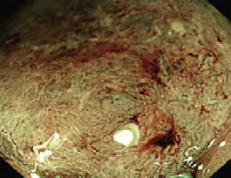
Colorectal Cancer
High incidence
Low survival rate of terminal colorectal cancer
Missed diagnosis and misdiagnosis in the early stage
NBI: focus on vessel shape

Slide 3
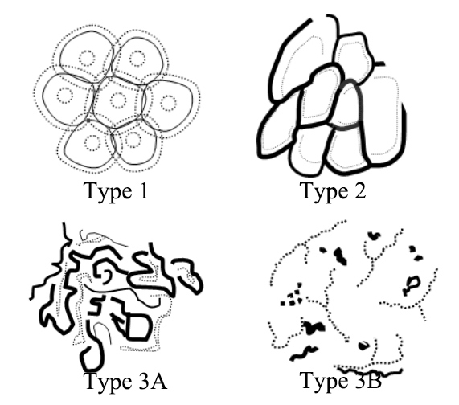
Motivation
With the deterioration of the colonic polyps, the vessel smoothness lowers:
Observation 1: each vessel tends to have more sharp corners and distortions as cancer deteriorates-> # of corners per vessel may increase
Observation 2: there exits more dilation and breakage as cancer deteriorates-> standard deviation of diameter of each vessel may increase

Slide 4
Vessel Smoothness
Three feature has been designed to estimate the vessel smoothness regarding the corners and changes of vessel diameter:
Number of Vessel Corner (NVC)
Standard Deviation of Vessel Diameter (SDVD)
Number of Abnormal Vessel (NAV)

Slide 5
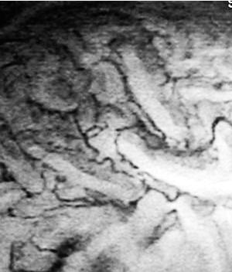
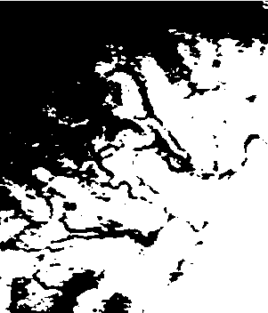


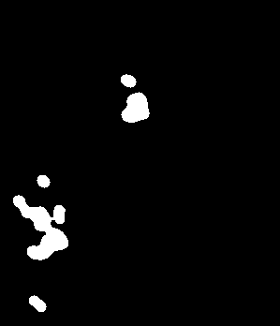

Preprocessing
Binarization
Mathematical morphology
Median filter to remove noise
Clear border regions
For each focal zone image, suppose there are $n$ vessels $v_{i}, i=1, 2, 3,…,n$
Original Image
After Binarization
After Mathematical
Morphology
After Applying
Median Filter
After clearing
Border regions

Slide 6

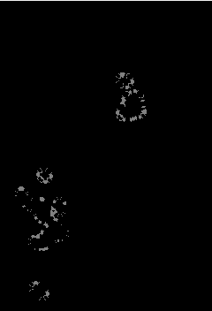

Number of Vessel Corner (NVC)
Use Harris corner detection method to calculate average number of vessel corner per vessel, where $num_corner$ is the total number of corners in the image, $n$ is number of vessels.
$$NVC=\frac{num_corner}{n}$$
Focal zone image
After Harris corner detection

Slide 7
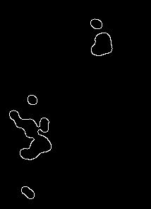
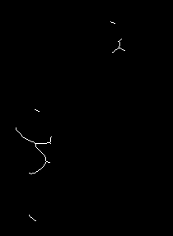
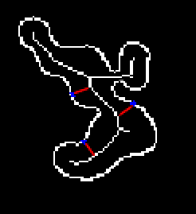
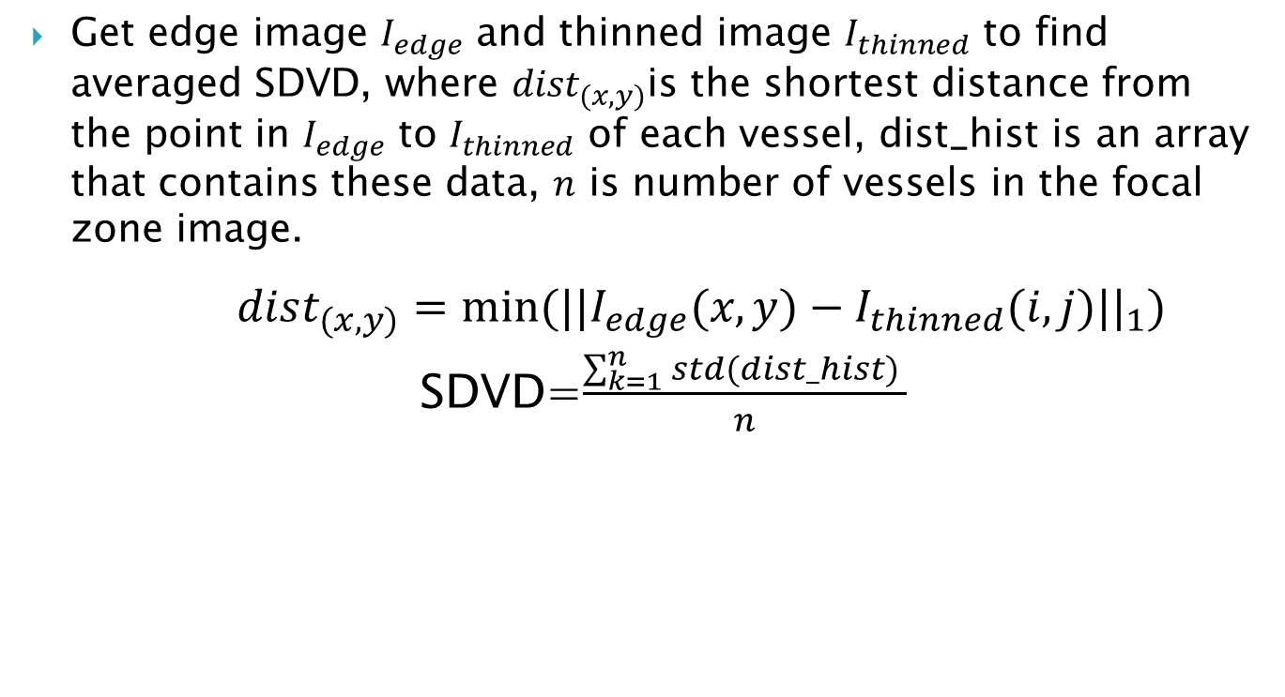
Standard Deviation of Vessel Diameter (SDVD)
Get edge image $I_{edge}$ and thinned image $I_{thinned}$ to find averaged SDVD, where ${dist}_{(x,y)}$is the shortest distance from the point in $I_{edge}$ to $I_{thinned}$ of each vessel, dist_hist is an array that contains these data, $n$ is number of vessels in the focal zone image.
$dist_{(x,y)}=min⁡({{||I}_{edge}(x,y)−I_{thinned}(i,j)||}_{1})$
SDVD=$\frac{\sum_{k=1}^{n}{std(dist_hist) }}{n}$
Edge image
Thinned image
Each point has one shortest distance

Slide 8
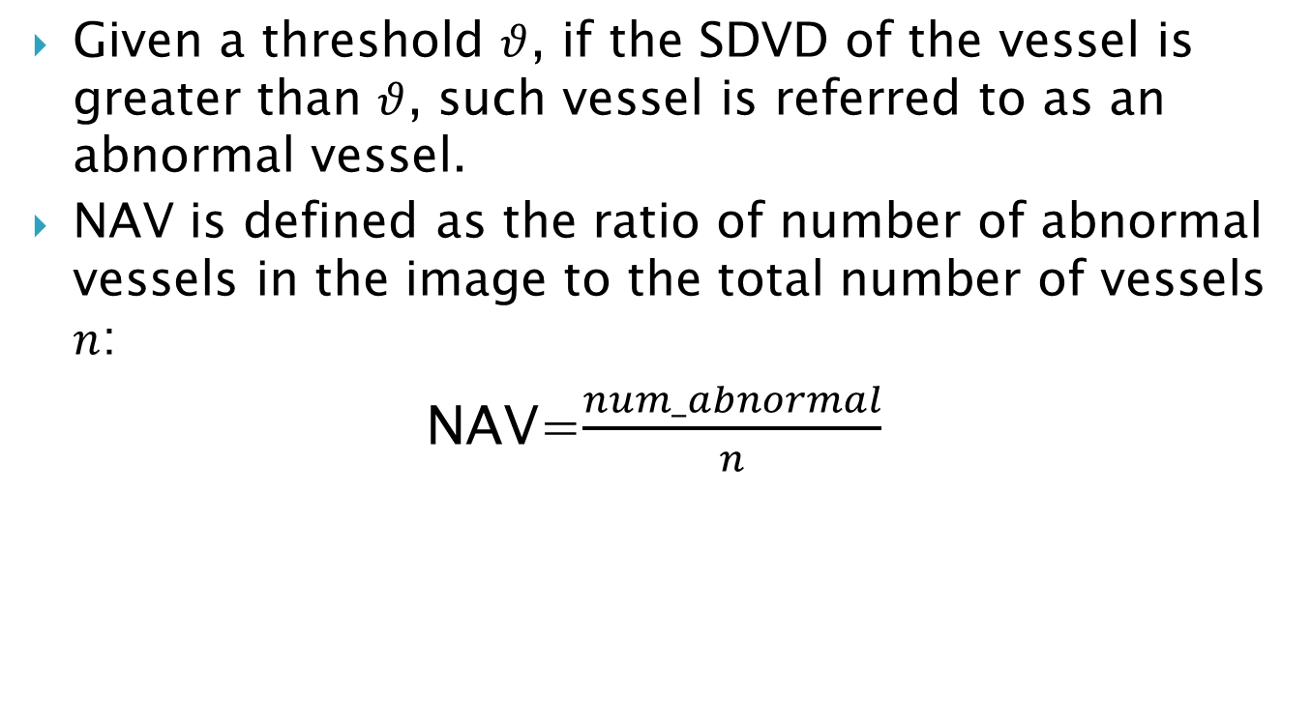
Number of Abnormal Vessel (NAV)
Given a threshold $θ$, if the SDVD of the vessel is greater than $θ$, such vessel is referred to as an abnormal vessel.
NAV is defined as the ratio of number of abnormal vessels in the image to the total number of vessels $n$:
NAV=$\frac{num_abnormal}{n}$

Slide 9
Feature Usage
NBI Image
Type I VS others
Type II VS others
NVC&SDVD
Type IIIA VS
Type IIIB
Type I
NVC&NAV
Type II
NVC&NAV
Type IIIA
Type IIIB

Slide 10
Experiment Result-K-means cluster
Using the same database of 55 samples, containing 5 Type I samples; 24 Type II samples; 19 Type IIIA samples; 7 Type IIIB samples.
K-means cluster is trained for each classification task.
Accuracy | Proposed Method | Comparison Method
Type I vs others | 81.82% | 65.5%
Type II vs Type IIIA & IIIB | 50% | 60%
Type IIIA vs Type I | 69.23% | 61.9%

Slide 11
Experiment Result-Linear SVM
Using the same database of 55 samples, containing 5 Type I samples; 24 Type II samples; 19 Type IIIA samples; 7 Type IIIB samples.
A linear SVM is trained for each classification task.
Accuracy | Proposed Method | Comparison Method
Type I vs others | 84.173% | 81.16%
Type II vs Type IIIA & IIIB | 59.513% | 60.79%
Type IIIA vs Type I | 81.22% | 74.20%
* Comparison Method: Hsu C C, Yang Z Y, Hsu C M. An Automatic Colonic Polyp Type Identification System by Narrow-Band Imaging and Focal Zone Features of Vascular Shapes and Patterns[C]//Innovations in Bio-Inspired Computing and Applications (IBICA), 2012 Third International Conference on. IEEE, 2012: 144-147.

Slide 12
Analysis- Type I VS others
1.Type I VS others:
The accuracy of our methods is no less than that of comparison method.
There are some vessels are oval- or bar-shaped in Type II, the comparison method may mistake Type II for Type I if there are too many oval-shaped vessels.
Our methods calculate corners and standard deviation of a vessel, which can avoid this situation.

Slide 13
Analysis- Type II VS Type IIIA & IIIB
Type II VS Type IIIA & IIIB:
Although we don’t get ideal result by using our method, we still believe that it’s a right direction to find methods to distinguish a vessel is normal or not.
The vessels in Types I and II have regular shape, they are normal; those vessels that have irregular shape in Types IIIA and IIIB are abnormal.
Irregular shape blood vessels have more corners and larger standard deviation, the question is to find a threshold to distinguish between normal and abnormal vessels by using standard deviation, maybe we used improper threshold. We will focus on finding a better way to define abnormal vessel.

Slide 14
Analysis- Type II VS Type IIIB
Type IIIA VS Type IIIB:
Apparently we get the satisfactory result. This proves that we need to find some features to judge a vessel is normal or not, or describe the degree of abnormal vessel. Type IIIB has more abnormal vessels, and these vessels have more corners, so our two features can get a high accuracy.

Slide 15
Conclusion and Future Work
Number of Vessel Corner is an appropriate feature that measures deterioration degree of colonic polyps, we need to improve corner detection algorithm to increase the accuracy.
Standard Deviation of Vessel Diameter is not good at Adenoma Classification, maybe it’s because we used inappropriate image processing method.
When we calculate the number of abnormal vessel, the threshold is important, we need to do more experiments to find an appropriate value.

